Slide 1


Workshop: Find the Odd One Out

Slide 2

Workshop Objective
Learn to reason as a team to solve a simple algorithmic problem
Follow the CARE Method:
Comprehend the problem
Analyze the data
Realize a solution (implementation)
Evaluate results
Expected output: the number that appears an odd number of times

Slide 3

Problem context
You are given a list of integers.
All numbers appear an even number of times, except one that appears an odd number of times.
our task is to identify that unique number.
This type of problem is useful for detecting anomalies and ensuring data consistency.
Example:
Input → [2, 3, 5, 3, 2, 5, 2]
Output → 2 (because it appears 3 times → odd)

Slide 4
Team Roles
To ensure efficient collaboration, each team member is assigned a specific role:
-Group leader : Organizes the work and manages the timing
-Analyst : Designs the algorithm and writes the pseudo-code
-Developer: Implements the solution in JavaScript
-Tester: Validates the results and identifies edge cases
-Spokes person: Presents the project and explains the approach

Slide 5
Logical Observation
01
02
03
-Numbers that appear an even number of times are ignored
-The number with an odd count is identified as the unique number we are looking for
The goal is to find the number that appears an odd number of times in a list
For each element in the array, we count how many times it appears by using an inner loop
This method ensures correctness because every element is checked against all others, so the odd occurrence will always be found

Slide 6
Optimal Strategy
To find the number that appears an odd number of times:
01
02
03
When the count is finished:
-We check if the count is odd
-If yes → this is the number we are looking for
-We display a message showing that number
For each element, we start a second loop
→ This loop counts how many times the current element appears in the array
We loop through the array element by element

Slide 7
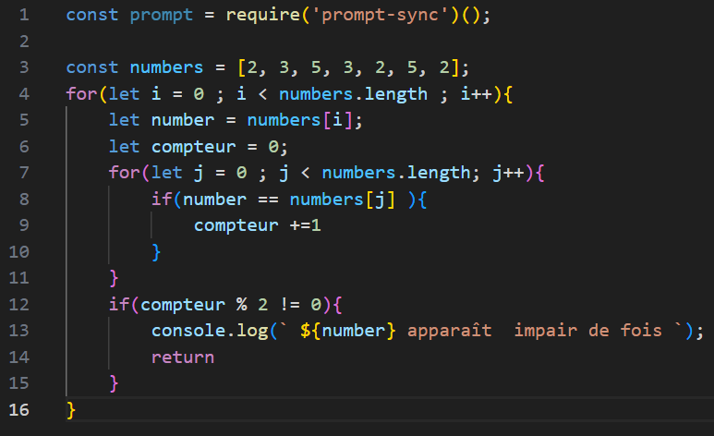
Java Script Code

Slide 8

Conclusion
This workshop helped us solve a simple algorithmic problem using teamwork and logical thinking.
We successfully identified the number that appears an odd number of times using a double-loop method in JavaScript.
It allowed us to improve our coding skills and collaboration

Slide 9


THANK YOU FOR YOUR ATTENTION!

